Slide 1


Fundamental of business Lesson 1
Instructor: P Pavalaxan

Slide 2
Learning outcome
Exploring Vision, Mission, Objectives, Strategies, and Tactics
Recognizing the Vision & Mission Statements of an Organization
Applying Vision, Mission, and Goals Statements
Utilizing the SMART Tool for Objective Creation

Slide 3
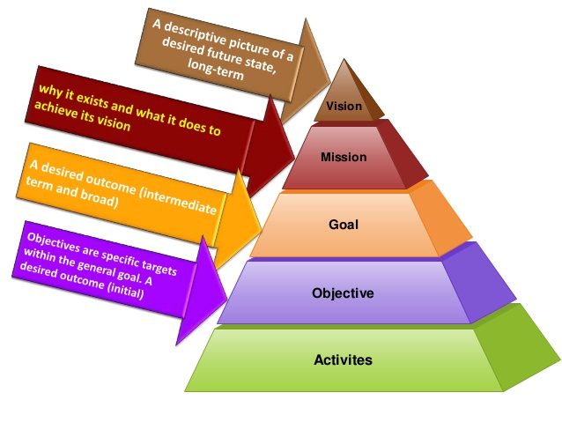
Vision, Mission, Objectives, Strategies And Tactics

Slide 4
Vision:
A vision is a Big Picture of “What” the organization wants to achieve in Future. It should inspire people in the organization. It excites people to be part of “What.” And, also motivate to put their energy and time to achieve the future
A good vision statement inspires to create a movement. It describes the desired outcome to invoke a mental image of the organization.
Mission:
A Mission is about what the organization does to achieve the vision. A mission is an action statement to achieve the vision.
A mission statement is not required to be inspirational. Instead, it provides a clear focus on what an organization does and what it doesn’t.
example of an agriculture business: “A Vibrant Economy is driven by value-added agriculture” Here the Vibrant Economy has the ability to inspire the people involved in this agricultural business.
“To create and facilitate the development of value-added agriculture” Here “Create and facilitate” are two clear focus areas

Slide 5
1. List few example of vision and mission statement of 3 organizations – work in a group
2. Compare the deference between vison and mission
Eexercise 1
Vision and Mission

Slide 6
1. What is our ideal future/world/society?
2. What is the biggest difference we could cause?
Eexercise 2
Vision
think about your ideal future
Get your team or a few colleagues together
Imagine you could not fail
Ask yourself the following questions and note down some thoughts

Slide 7
What do we do and how?
Who do we do it for?
Why do we do it?
Use this phrase and modify your mission statement
We… for… because ..
Eexercise 3
Mission
think about how you will realise
your vision
Ask yourself the following questions and note down some thoughts

Slide 8
Goals and Objectives:
Goals are statements of mileposts to achieve the vision. Goals describe – what you want to achieve through your efforts.
And, an objective is a time-sensitive statement to achieve goals. We defined it in SMART
Improve profitability
I want to become known as an expert in business strategy
I will commit to my career development and learn how to manage a business
I want to build more business contacts
10k net profit as 20% of investment in the year 2022.
I will complete my business management degree in 2023.
I will attend 90% of my management lectures and ask/ clarify at least one question in all classes this semester.
I will work with the lecturers and my classmates to practise my networking skills by the end of this semester.

Slide 9
Goal and objective
 | Goal | Objective
Definition | Goals are statements of mileposts to achieve the vision. | Objective is a time-sensitive statement to achieve goals.
Specificity | General intention | Specific
Plan | Broad in scope | Narrow in scope
Size | Large | Small chunk
Actions | A general outcome | Specific actions and measurable steps
Measurement | Difficult - Intangible | Easy - tangible
Timeframe | Long-term | Medium/ Short-term

Slide 10
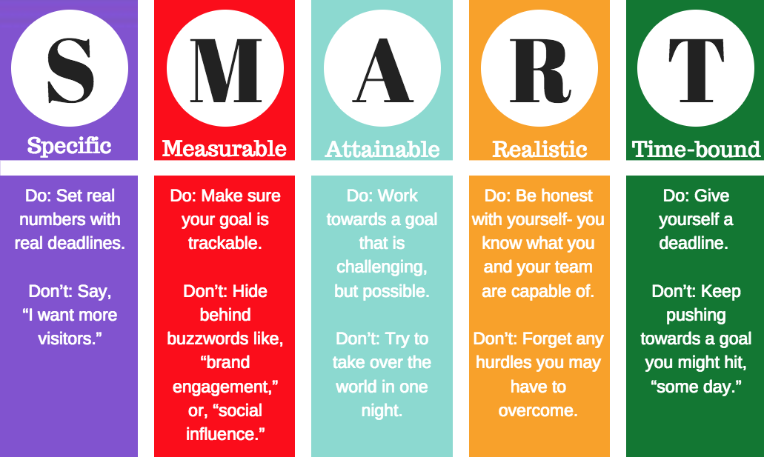


Slide 11
Strategies & tactics
Strategies are long-term implementation plans to achieve the goals and objectives. These statements define how you can succeed in achieving your mission and stay along in the completion.
Strategies are likely to be defined following a SWOT analysis as both external and internal environment assessment is needed as input to develop strategies.
Tactics are short-term implementation or action plan to deliver the long-term strategy. A grass-root level action plan is defined to ensure daily activities are in line with achieving the relevant strategy(s).
To development of market or product
“New distribution channel”
Sales staff members are expected to do 10 social media activities daily,

Slide 12
Ask yourself the following questions and note down some thoughts
Is it Specific? Can you quantify?
Is it Measurable? What are the measures do you have?
Is it Attainable/ Achievable? Is it possible within your timeline?
Is it Realistic? Do you/ your team have the capacity?
Time bound? Do you have deadline?
Eexercise 3
Objectives
think about what you will be achieving in next year.

Slide 13
Review

